Slide 1
Student Registration System
Ishwari Dawkhar 21810030(332009)
Pratik Jagtap 21810035(332025)
Sanket Deshmane 21810492(332012)
Digvijay Desai 21810440(332010)

Slide 2
Student Registration System
Student Online admissions are a vital part of any university’s running because students are what keep a College alive. The Student admission is one of the most important activities within a college as one cannot survive without students. A poor admissions system can mean fewer students being admitted into a university because of mistakes or an overly slow response time. But this online Student Registration system is very fast and efficient in comparison of the manual work which leads to a lot of errors.

Slide 3
Purpose
The purpose of this SRS system is to allow the registration of students in particular domain. It is intended to include complete specifications of what functionality the system provides. It will also facilitate keeping all the Online Student Registration records of students, such as their id, name, address DOB, etc. So all the information about a student will be available in a few seconds. Overall, it will make Student Online Registration System an easier job for the administrator and the student of any organization. The main purpose of this SRS system is to illustrate the requirements of the project Online Student Registration System and is intended to help any organization to maintain and manage its student’s personal data.

Slide 4
Scope
Without an Online Student Registration System, managing and maintaining the details of the student is a tedious job for any organization. Student online registration system will store all the details of the students including their background information, educational qualifications, personal details and all the information related to their resume.
Login Module: Login module will help in authentication of user accounts. User who have valid login id and password can only login into respective accounts.
Update/Delete Module: Suppose there are hundreds of students and from this we have to update/search a particular student and we know the name of the student , in manual system it is a tedious task though we know the name of the Online Student Registration 9 student, but using this module we can easily update/delete student by specifying the name of the student in the search criteria

Slide 5
Contribution in real world
This is an era of information technology where automation of each and every activity is gaining Importance. The site will lead to the automation of the registration system. Moreover it is far better than the previous such websites.
It deals with the functionalities required from the system which are as follows: 1) The website will help the colleges/organizations/companies to conduct their student registration 2) Only authorized person can access related details. 3) Organizations can change their information regarding themselves. The students can login through their TEST-ID and PASSWORD only.

Slide 6
frameworks
Personal Details: Details of student such as user id, phone number, address, image, e-mail address etc.
Contact Details: Details of contact associated with the student.
SRS: System Requirement Specification
WWW: World Wide Web
MySQL: is a RDBMS based on SQL which is used for adding, removing, and modifying information in the database.
RDBMS: Relational Database Management System
HTML: Hypertext Markup Language
PHP: Hypertext Preprocessor
CSS: Cascading Style Sheet
HTTP: Hypertext Transfer Protocol

Slide 7
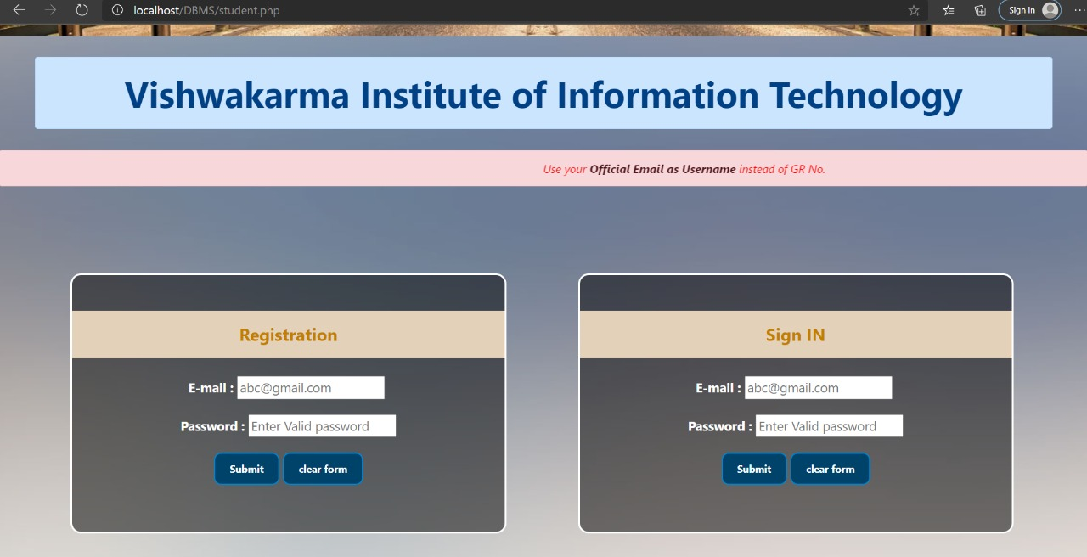
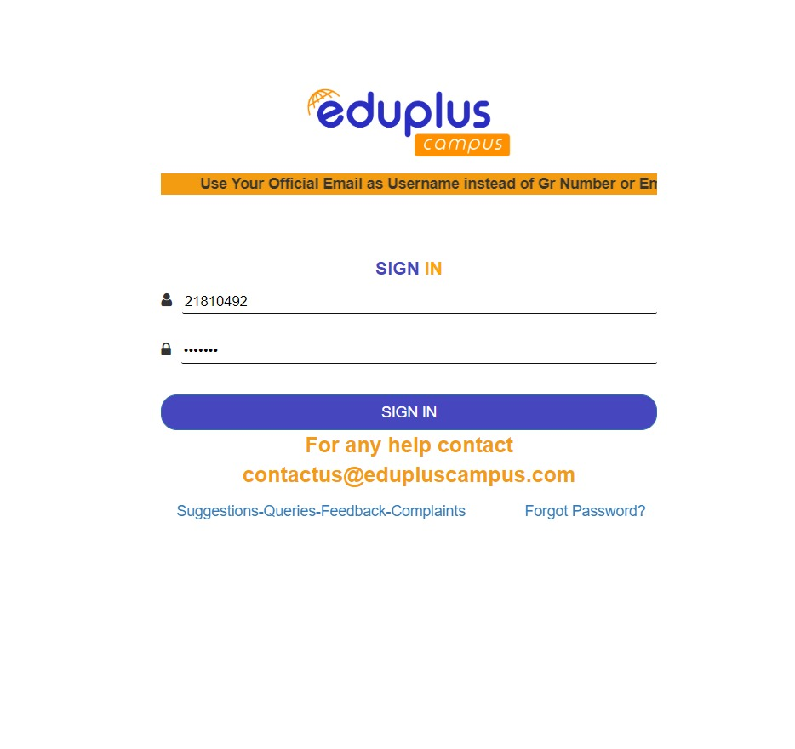
Results

Slide 8
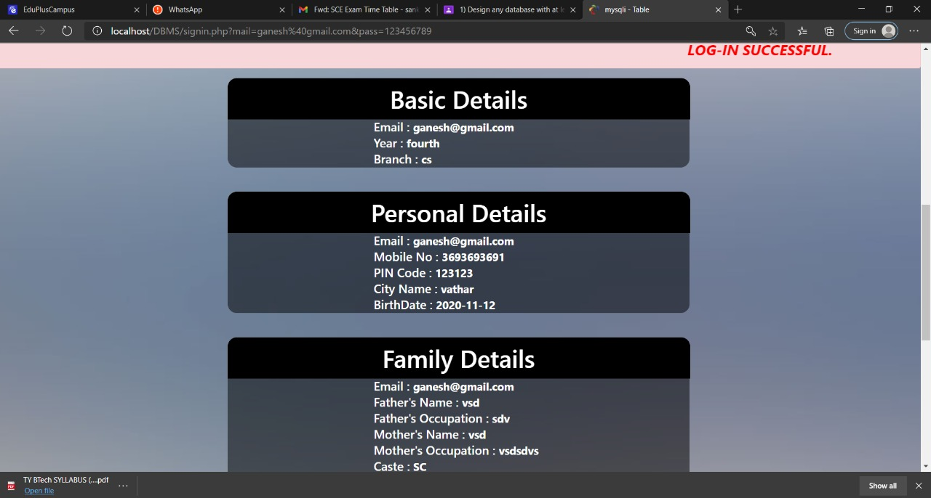
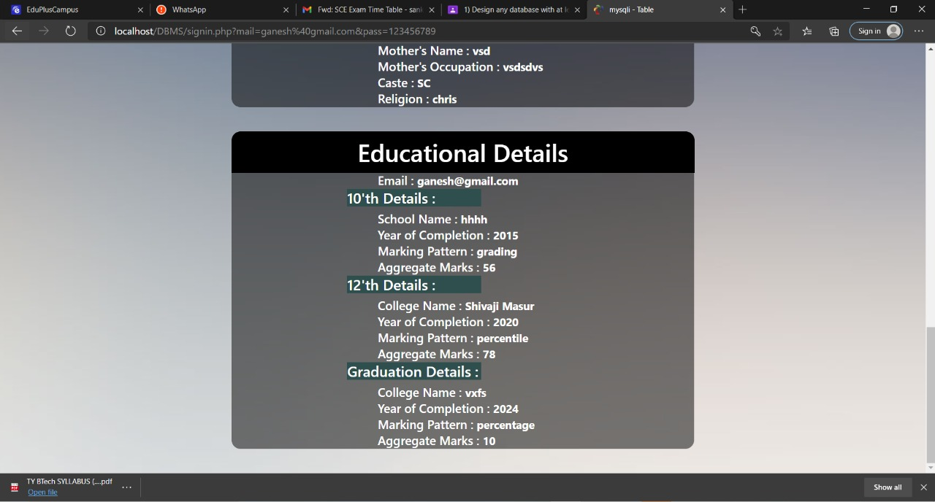
Results

Slide 9
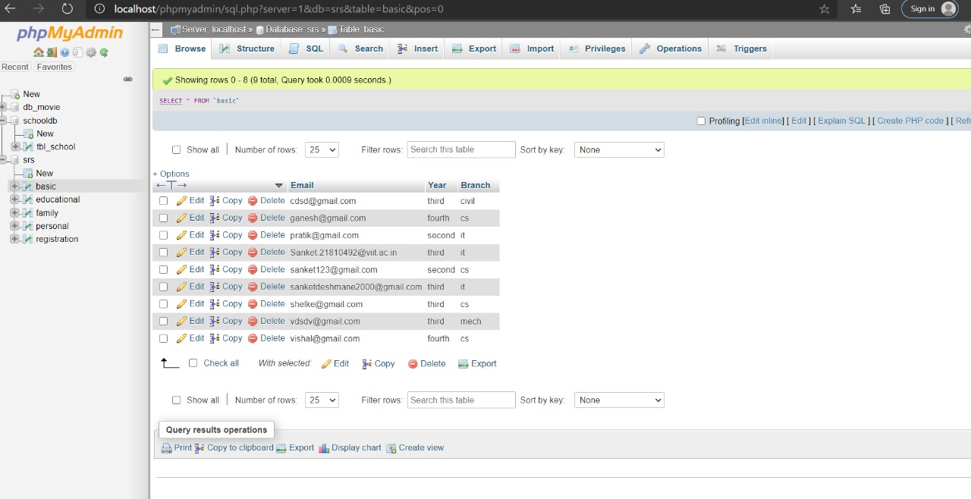
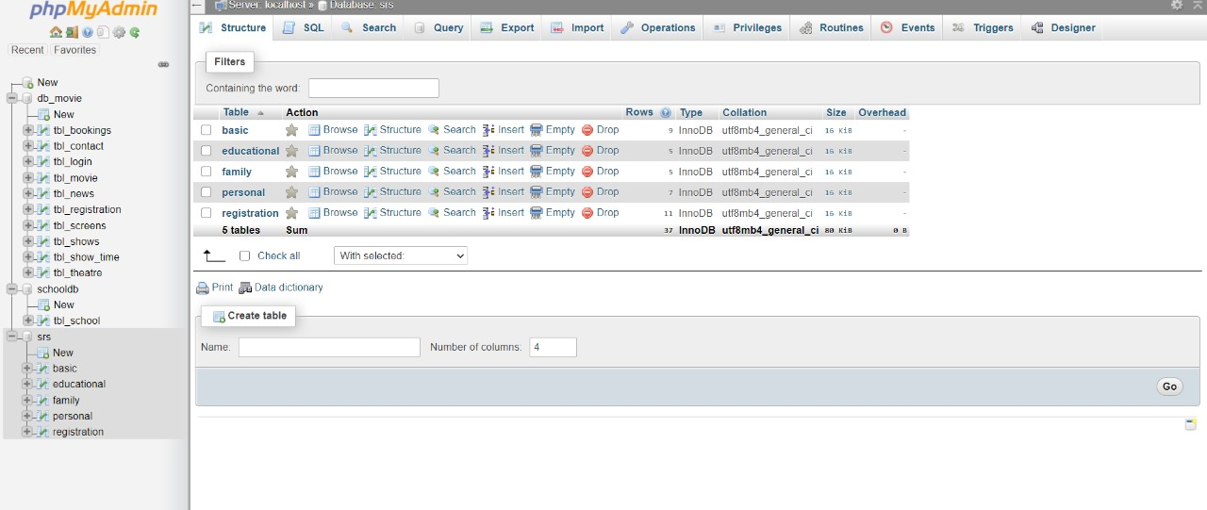
dATABASE

Slide 10
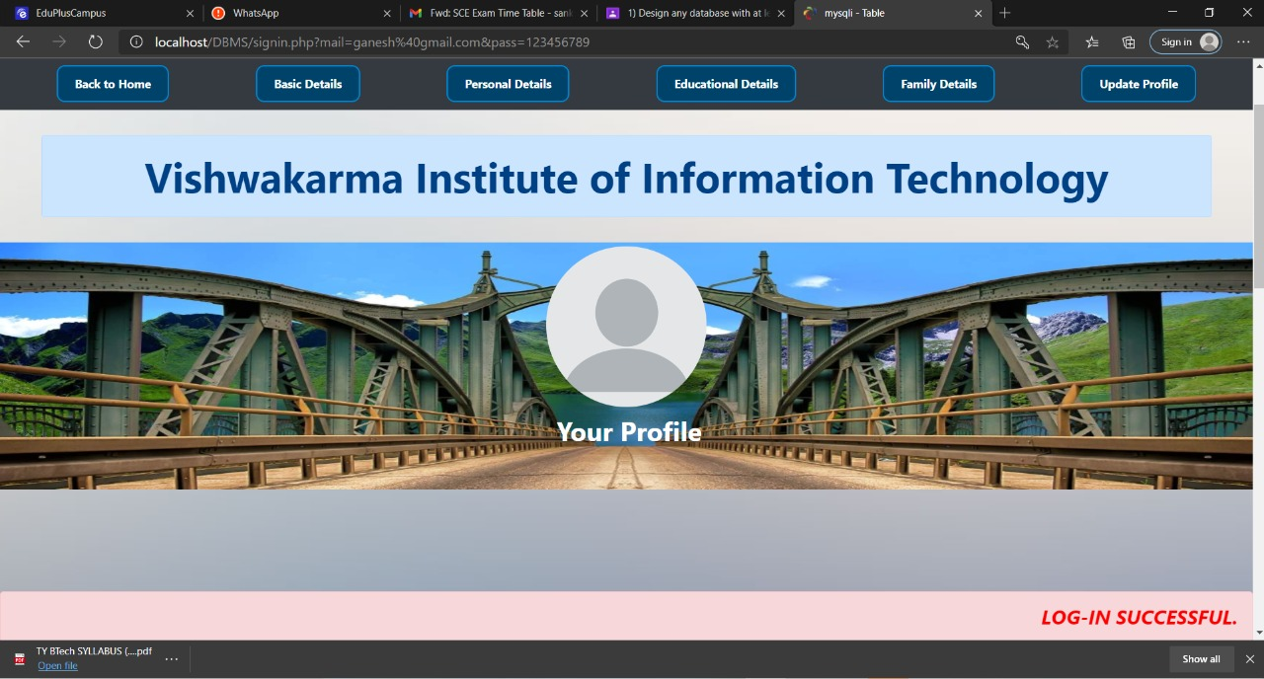
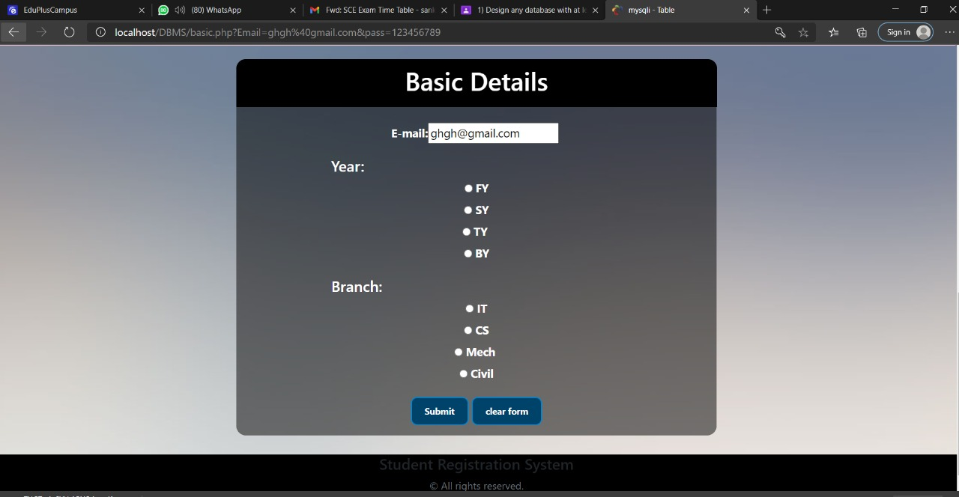

Slide 11
CONCLUSION
The project will be useful for any schools and colleges with slightly modification. Project is flexible i.e. any change /modification in database may be performing easily. Also this project could be made web enabled by hosting and be used by organizations as well. Database Management System is very useful to create databases as per the requirements and it includes the use of the database and other application programs and also provides an interface between the data and the software application. This project helped us to collect, manage and disseminate information very efficiently as well.

Slide 12
Thank you

